Slide 1

OPEN SOURCE TOOLS
CS-19

Slide 2
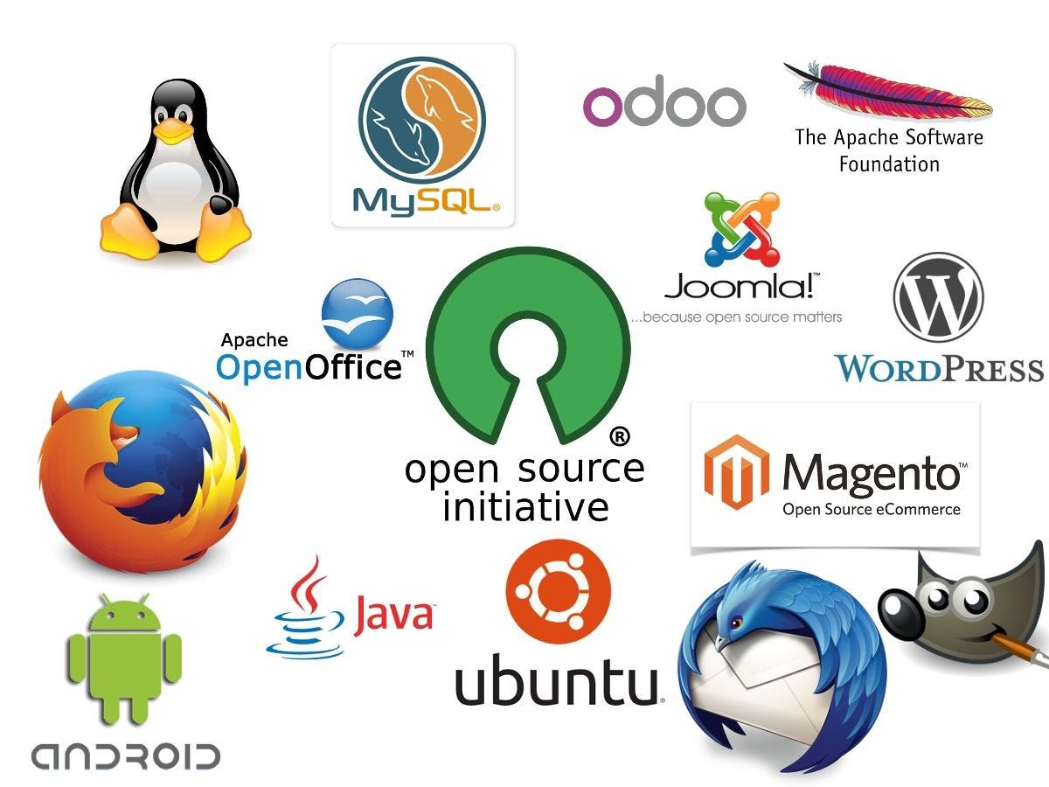
Unit:1 open source software
Understanding open source software
Open source licensing
Application of open source
Open source operating system

Slide 3
Que : Software you can download free of cost and use it, but can’t change its source code is called
FreeWare
Open Source Software
Free Software
None of the above
Ans: _____________.

Slide 4
Free ware | Free Software | Open Source Software
Describing Software that can be freely (free of cost) downloaded and used. | It means that the users have the freedom -To run, copy ,distribute, study, change and improve the software. | Open source software is something that you can modify as per your needs, and share with others without any when we say licensing violation burden
But which may contain restriction or modification and reuse. | No restriction are imposed on free software. | The source code of the software is available publically which allows you to edit the source code and distribute it.
That is you can’t change source code. | Free means freedom not free of charge or cost. | Open source software occasionally impose some constraint on use .it is not always free of charge.

Slide 5
Understanding open source software
Definition:
Open source software (OSS) is software that is distributed with its source code, making it available for use, modification, and distribution with its original rights.
Source code is the part of software that most computer users don’t ever see; it’s the code computer programmers manipulate to control how a program or application behaves.
Programmers who have access to source code can change a program by adding to it, changing it, or fixing parts of it that aren’t working properly.
OSS typically includes a license that allows programmers to modify the software to best fit their needs and control how the software can be distributed.

Slide 6
Difference between Open Source Software and Closed Source Software
With closed source software (also known as proprietary software), the public is not given access to the source code, so they can't see or modify it in any way.
But with open source software, the source code is publicly available to anyone who wants it, and programmers can read or change that code if they desire.

Slide 7
Principles of open source
Openness
Transparency
Security
Flexibility
Derived Works
Licence Management
Affordability
Community
Collaboration
Release Excitement
Innovation

Slide 8
Principles of open source
Free as in ‘Freedom’ Not ‘Zero Cost’
Open source is not free.
In 1998 the term ‘open source’ was coined to because many people assume any use of the word ‘free’ to mean ‘zero cost’ and so assume ‘free’ software the same as freeware. In the context of open source the freeness relates to the freedoms that are provided by the licenses.
It is true that an organization could use open source software and support itself by hiring technical staff with the necessary skills to:
Evaluate and select the most suitable open source software or software distribution.
Integrate and embed the open source software into internal systems.
Fix any critical defects that are found.
Train any users or new technical staff.

Slide 9
Organizations have the freedom to do all these things but they should not consider fulfilling these needs to be of zero cost.
If you accept that open source software is not a zero cost solution you must then accept that these costs can occur in the form of time (internal man hours) or money (given to some external organization) or both.
In addition to the costs above there are also risks to be managed. In fact if you look at the commonly listed barriers to the adoption of open source software you will find that most of them are related to some kind of risk.
It is difficult for many organizations to manage all of these risks themselves: the number of people and the range of skills required to do so is prohibitive. For small organizations or low-risk projects these risks can be tolerated but for larger projects risk management is a significant issue.

Slide 10
Principle of ‘Openness’
Accepting feedback through a web page and providing mechanisms for people to report defects is one thing.
Allowing everyone else to see that feedback and all those defects is another, much more uncomfortable, step.
Allowing everyone to see the source code so they can review it and try it is also an act of faith. Providing a public forum where people can openly criticize and contribute to the design and implementation of the software is another act of faith.
These are difficult behaviours for a proprietary organization to accept but open source projects rely on them. If the project administrators do not provide mechanisms for people to communicate openly amongst themselves there can be no community.
The availability of the design documents and source code enables the community to provide peer reviews and to use the software for their purposes and provide feedback on the quality.

Slide 11
Principle of ‘Transparency’
Transparency is the ability of the community to see what’s going on. This involves:
A published road map so they know where the administrators plan to take the project.
A public defect tracking system so they can report and review defects.
Published design documentation.
Communication about schedules and hurdles.
Without transparency it is hard to grow a community.
Transparency and openness are not the same thing. A glass door is transparent but whether it is open or not is a different matter. Transparency is the ability to witness the inner workings, openness is the letting outsiders ‘in’ so they can participate.

Slide 12
Principle of ‘Early and Often’
This is the philosophy of making information available in its earliest drafts and updating it often.
This includes, but is not limited to, the source code of the software. Zipped archives of the source code are available for every open source project.
Many projects go further and have a public repository where the current code is always available. As the developers change the source code and check it in, it is available to anyone who wants to review it or use it.

Slide 13
What is the history of open source software?
open source is an idea. It’s a concept that revolves around access. You can access someone else’s source code (or even a company’s). This way, you can customize it for your use case, find bugs, and fix them too.
Better still, you can share your “version” of the source code with others in addition to the original.
The person who writes the inceptive source code gives this access, which is an invitation to contribute, based on existing licenses. Different licenses will have certain limitations or obligations.
Developers did not want to keep paying for software that did not meet their use cases, had bugs that they could not always fix, and had security issues.
Richard Stallman, who is hailed as the father of open source, seems to prefer to use “free software” instead.

Slide 14
The 1950s – the A-2 system
In 1953, the A-2 system (an equivalent of today’s compilers) was released together with its source code, and customers were asked to send any improvements to UNIVAC (the Universal Automatic Computer).
UNIVAC was a division under Remington Rand, Inc., an early American business machine manufacturer.
The 1980s – GNU
In 1983, however, Richard Stallman started to work on the GNU project, which was made up of rewrites of closed software he frequently used.
GNU stands for "GNU’s Not Unix" and is pronounced as “g-noo”.
In 1984, Stallman spearheaded the creation of the GNU, a free operating system that was made to counter closed systems.

Slide 15
In 1985, he wrote the GNU Manifesto, asking for support in the development of the GNU operating system.
He also founded the Free Software Foundation (FSF), a nonprofit that was aimed at promoting freedom in computer use.
By 1987, most of the essential components of the GNU operating system were complete. There was an assembler, editor, and various Unix utilities like grep and ls.
In the 1980s, Stallman also created the GNU General Public License (GPL). All the components of the GNU operating system were released under this license.
Today, the GPL allows for the freedom to share and change all program versions, ensuring that they remain accessible to all users.
This new approach and ideology surrounding software creation took hold and eventually led to the formation of the Open Source Initiative (OSI)in 1998.

Slide 16
What is an Open-Source License?
Open-source software license definition says that these are legal agreements that determine the rules under which users can access and modify the code of open-source software. These licenses typically allow users to use, change, and distribute the software freely, as long as they follow certain conditions outlined in the license.
Open-source software licenses provide a legal framework that protects both the rights of the software creators and the users. In simple terms, they are like rules for using and sharing free software

Slide 17
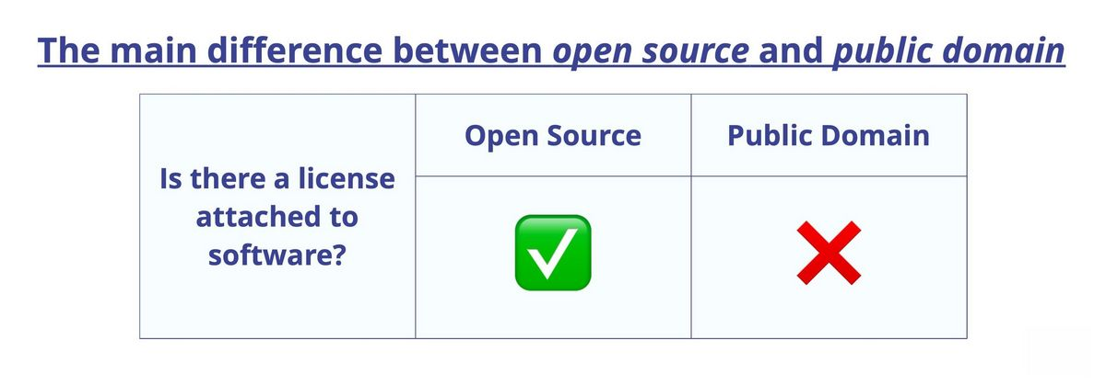
What's the Difference Between Open-Source and Public Domain?
Open-source refers to software or other works that have an open-source license, which allows for free use, modification, and distribution. The license sets specific rules for usage and distribution but encourages collaboration and sharing of the work.
Public domain includes works that are not restricted by copyright and can be used, modified, and distributed without restriction. This can happen when a copyright has expired or when the creator chooses to give up their rights to the work.
The main difference between the two is that open-source has a license that sets rules for usage, while public domain has no restrictions at all.

Slide 18
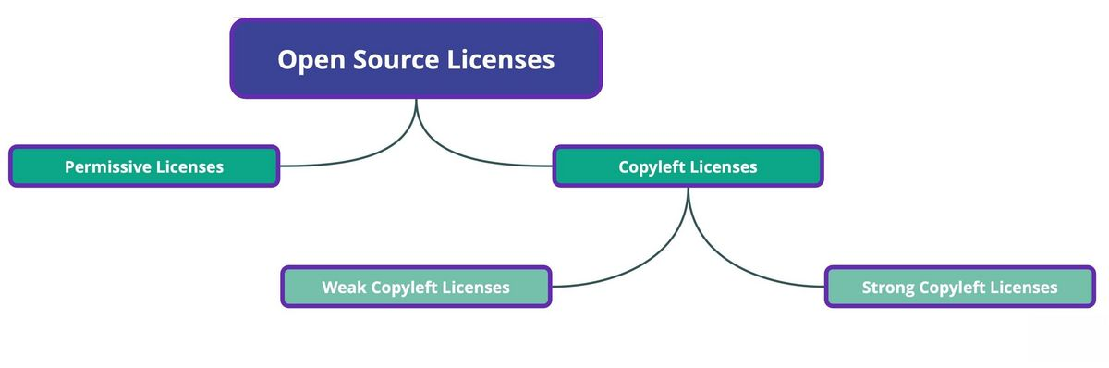
Open-Source License Categories: Copyleft and Permissive
Based on the obligations and limitations imposed on users by the license, there are two main open-source license categories - copyleft and permissive licenses.

Slide 19
Copyleft? You Mean Copyright, Right?
While copyright restricts the use and distribution of a work, copyleft licenses allow that as long as the terms stated are obeyed.
Imagine you wrote a cookbook and you have the copyright to the book. This means that only you have the exclusive right to use, sell, and distribute the book. No one else can sell or distribute copies of your book without your permission.
Now, imagine that you wrote an open-source cookbook and released it under a copyleft license. This means that anyone can use, modify, and distribute the book for free, as long as they also share their modifications and any derivative works under the same copyleft license. In this case, the book becomes a collaborative effort, with everyone adding and improving the recipes.
As explained in this example, copyright gives the creator control over their work, while copyleft encourages collaboration and sharing. Let's have a closer look at each of them.

Slide 20
Copyleft Definition
Open-source software licenses in this category allow for the free distribution and modification of a work, as long as any derivative works are also licensed under the identical license.
It is meant to ensure that the work remains open and freely available for future use, modification, and distribution. To put it another way, your modifications must remain just as open and accessible to everyone with identical rights and privileges afforded by the initial version.
These open-source software licenses can be further divided into:
1. Strong copyleft licenses
2. Weak copyleft licenses

Slide 21
1. Strong copyleft licenses
If a source code is protected by a strong copyleft license, then the derivative software needs to be publicly available under that license as well.
This includes all linked libraries and components within the software. For example, if someone modifies and distributes software under a GPL license, they must also make the source code available and license their modifications under the same GPL license. So if you plan to develop software and offer it as proprietary, these are open-source licenses to avoid.
2. Weak copyleft licenses
The requirements of a weak copyleft license are similar to those of a strong one, but they apply to a limited set of codes.
This open-source license only requires that the source code of the original or modified work is made publicly available, while the rest of the code used together with the work doesn't have to be published under the same license.

Slide 22
Permissive Licenses
Permissive open-source licenses are a type of open-source license that allows for greater flexibility in the use and distribution of open-source software.
Permissive licenses, such as the MIT License and the BSD License, place minimal restrictions on the use, modification, and distribution of the software.
With permissive licenses, users are free to use the software for any purpose, including commercial purposes, and are not required to release the source code or license their modifications under the same terms.
This allows for greater flexibility in the use and distribution of the software, but can also lead to the creation of closed, proprietary derivative works.

Slide 23
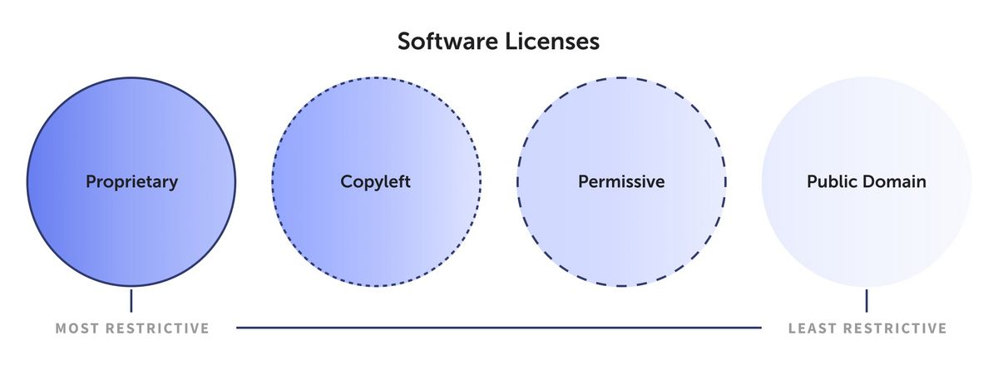
Permissive licenses are often favored by businesses and individuals who want to use open-source software as a component in their own proprietary software, as they provide greater freedom to use the software in their own projects.

Slide 24
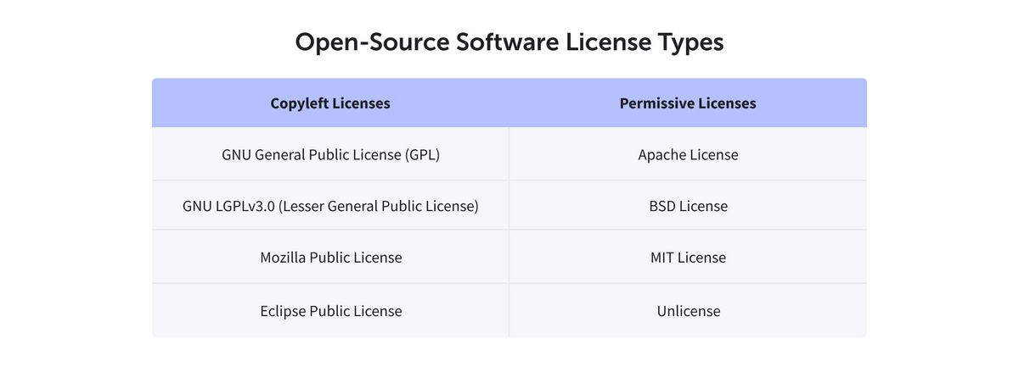
Open-Source License Comparison
Open-source licenses are numerous and this is where Open Source Initiative (OSI) plays a crucial role. It is a non-profit organization that promotes and protects open-source software through the development and enforcement of open-source licenses.
These are some of the most popular OSI-approved open-source licenses.

Slide 25
Permissive Open-Source Licenses
MIT License
Created by the Massachusetts Institute of Technology, the MIT license . It states that the source code can be used in any way with the only requirement to preserve copyright and license notices. MIT license is used by Babel, .NET, and Rails, to name some of the famous open-source software solutions.
Apache License
The Apache license was released by Apache Software Foundation (ASF). As a permissive license, it grants developers the flexibility to distribute their work under any preferred license, as long as they credit the initial one and carefully document all modifications made to it.
You have the option to keep some of your materials as a closed source and can obtain licenses that allow you to monetize them or even secure a patent. Some famous software solutions protected by Apache license are Kubernetes, PDF.js, and Swift.

Slide 26
Copyleft Open-Source Licenses
GNU General Public License (GPL)
GNU GPL is one of the first open-source software licenses and is also among the most popular copyleft ones. It belongs to strong copyleft licenses as it requires users to share any modifications they make to the software and to make the source code of their modifications available to the public. Even if the GPL code takes just a small percentage of the new software, the source code of the whole new software has to be available under the same GPL license.
There are several versions of GPL licenses with differences that make them more or less applicable and compatible with other licenses. All the details can be found on the GNU website. For example, GIMP and Bash use this license type.

Slide 27
Mozilla Public License (MPL)
As a weak copyleft license, Mozilla Public License claims that if a derivative work modifies code licensed under MPL, it also has to be licensed under the same license.
But, if the MPL code is kept in separate files without any modifications made to it, the derivative work can be combined with non-MPL code to create a larger work, and only the MPL part of the code has to be distributed with the software. Servo, Synching, and TimelineJS3 are among the users of this license.
Eclipse Public License (EPL)
EPL is also a weak copyleft license. If you choose to modify an EPL component and distribute it as part of your program's source code, disclosure of the modified code is necessary.
On the other hand, if you provide only object code for distribution, then you must clearly communicate that recipients are able to request the original source code from you along with a description of how to make such requests.

Slide 28
What kind of open source license risks are there?
There are many ways to categorize open source license risks. Our software audits group classifies risks based on priority. For example, some licenses in your codebase might be OK to use as is, but others might be in conflict with other licenses, so you'd need to research them before proceeding.
We further classify risks based on type of license (e.g., permissive or restrictive), which reflects your legal exposure if you use components that have those licenses.
Our guide to the top open source licenses lists some of the most popular open source licenses according to these risk categories:
Low risk. Permissive licenses are consider low risk because it's easy to meet their reuse requirements: Usually you just have to retain the copyright notice, but you don't have to expose your source code. Examples are the Apache and MIT Licenses.

Slide 29
Medium risk. Semi-permissive licenses, sometimes referred to as limited licenses, weak copyleft licenses, or simple copyleft licenses, are considered medium risk because if you modify the code, you have to release the modifications, but not your whole application, under the same license. Different licenses define "modification" differently. Examples are the Mozilla and the Eclipse Public Licenses.
High risk. Restrictive licenses carry a great deal of legal risk. If you use a component with one of these licenses, you might be legally obligated to release your entire application code. Examples are the GNU GPL and GNU LGPL.

Slide 30
Why use open source?
Let's say you're starting a company and the business model requires you to develop an app. Rather than reinvent the wheel by writing your own SSL, you might consider using OpenSSL. The current licensing on OpenSSL is Apache-style.
That means it's a permissive free software license. However, OpenSSL is also dual licensed, so read the download library files carefully.
It's OK to use open source code, but you need to analyze it. You should know what license the component has, whether the library files are current, and whether there are any outstanding CVEs for the latest version. A good software composition analysis tool can give you this information.

Slide 31
is it risky to use open source software?
Permissive open source licenses generally allow you to use an open source component freely as long as you maintain any copyright notices.
But if you use a component with a restrictive license in your proprietary software, you might be legally obligated to release your software under the same license (i.e., as royalty-free open source software).
As long as you are managing your use of open source (i.e., you know what's in your codebase and what kind of licenses are attached), you can manage your legal risk. But be aware that very few organizations track their open source use well, if at all.
The others are all exposing themselves to legal risk.

Slide 32
Key factors to consider when choosing an open-source license
1. License compatibility
One of the primary factors to consider when choosing an open-source license is license compatibility. This refers to the ability to use, modify, or distribute code under the terms of another license. I.e. when you want to integrate code from one project with a different license into your project.
Not all licenses are compatible, as they may contain conflicting requirements. For example, a GPL-licensed project cannot include code from an Apache-licensed project, because the GPL's requirement for a full copy of the license text in every file conflicts with the Apache license's more relaxed terms.

Slide 33
2. Restrictions and requirements
Each license comes with its own set of restrictions and requirements. For instance, the MIT License requires the inclusion of the original copyright notice and license text in all substantial copies of the software.
The GPL, on the other hand, requires that derivative works must also be GPL-licensed. It is crucial to understand these restrictions and choose a license that aligns with the goals of your project.
3. Legal and intellectual property protection
Every open-source license offers some level of legal protection. They define the terms of use, distribution, modification, and contribution, which, if breached, can lead to legal consequences.
Understanding these protections can help you choose a license that best suits your needs

Slide 34
Contracts and licenses for your copyrighted works
Contracts and licenses also come into play in academic research and publication.
Graduate students license their theses and dissertations to open access repositories when completing degree requirements, and many also license their dissertations to the company ProQuest which holds a historical archive of theses and dissertations in its Dissertations & Theses Database.
Students also sign contracts with journal publishers and book publishers to get their works into publication. See section on “Copyright in Academic Research and Publication” for more information on contracts in your research and publication

Slide 35
Open source operating system
Fedora
Fedora is another popular Linux-based operating system, and it is widely considered the best open-source operating system after Ubuntu.
It is an RPM-based general-purpose operating system that is supported by Red Hat and built by the Fedora Project community.
Its purpose is to develop and share cutting-edge open-source technology for free.
As a result, Fedora developers prefer to make upstream improvements rather than create fixes specifically for Fedora. Fedora developers' updates are available to all Linux distributions.

Slide 36
It has a GNOME-based desktop that may be customized. Fedora comes with a customizable GNOME-based desktop. Its Fedora Spins feature allows you to customize and run several user interfaces and desktop environments.

Slide 37
Ubuntu
The Ubuntu operating system is based on Linux. Computers, cellphones, and network servers are all supported. Canonical Ltd, based in the United Kingdom, created the system.
All of the principles utilized to create the Ubuntu software are based on Open Source software development principles.
Ubuntu Desktop is a Linux distribution created by Canonical, and it is one of the most popular due to its simplicity. It's also one of the most popular Linux distributions for newcomers.
It's an operating system based on Linus Torvalds' Linux kernel, a UNIX-like system released in 1991. Linux distributions are often free and open-source, and many of them are excellent alternatives to mainstream operating systems such as Windows and macOS.

Slide 38
Mark Shuttleworth, a South African-British developer and entrepreneur, founded the Ubuntu Foundation in 2004. He sought to make a more user-friendly Linux distribution than Debian, which was at the time the most popular among Linux users. However, it was infamously difficult to install, and the Ubuntu Foundation set out to change that.

Slide 39
Applications of Open-Source Software
Some of the best open Source Applications are as follows:
Linux is widely used for servers and devices.
Mozilla Firefox and Chromium are open-source web browser choices.
LibreOffice and Apache OpenOffice are free alternatives to Microsoft Office.
WordPress and Joomla aid in website creation.
GIMP is for image editing, and Blender is for 3D content creation.
Postgre SQL and MySQL manage data in databases.
Apache and Nginx host websites and distribute traffic.
Eclipse and Git are development tools.
QGIS assists with maps and geographic data.

Slide 40
Conclusion
In conclusion, Open Source Software has made a significant impact on technology. It brings benefits like transparency, community support, and improved security. Users can freely explore, modify, and share the code, promoting collaboration and innovation. However, it’s important to acknowledge potential drawbacks, like its impact on the profit-driven software industry and funding source reliability.

Slide 41
Frequently Asked Questions
Q. Is Google an open-source software?Ans. No, Google’s main software like the search engine and Chrome browser is not open source. They’re developed by Google and are not freely available for anyone to modify. However, Google does release some open-source projects and software, like Android, which is used on many smartphones.
Q. What is the meaning of an open-source document?Ans. An open-source document is a file, like a text or Word document, that is freely available for anyone to view, use, change, and share. It’s open to the public, and people can collaborate on it. Open-source documents are often created to be accessible and editable by many.
Q. Is MS Office open source software?Ans. No, MS Office is not open-source software. It’s owned by Microsoft and is not freely available for everyone to modify. You usually need to pay for it or use a licensed version.

Slide 42
What is open source applications with examples?
Open source software is different. Its authors make its source code available to others who would like to view that code, copy it, learn from it, alter it, or share it. LibreOffice and the GNU Image Manipulation Program are examples of open source software.

